Slide 1
Growing a Streaming Service Microsoft
Han & Jeff

Slide 2

Best Type of film
Measure Genre success on 3 scales
Earnings per film
Earnings per dollar invested in production
User engagement measured through number of user ratings from data source
Best Times for release
Measure film release cycles

Slide 3


Measures of success
$
Profitability
ROI
Growth and Synergy
Each project maximizing earnings
Maximizing earnings per dollar-spend on production
Maximizing user engagement
Promoting Microsoft’s other offerings
Take advantage of Microsoft’s other offerings

Slide 4

Data
Data Sources:
IMDB
Film Details (Genres etc.)
Film Ratings
The-Numbers.com
Film Budgets (Box Office, Production Cost)
The Movie Database
Film Ratings
Film Genres

Slide 5
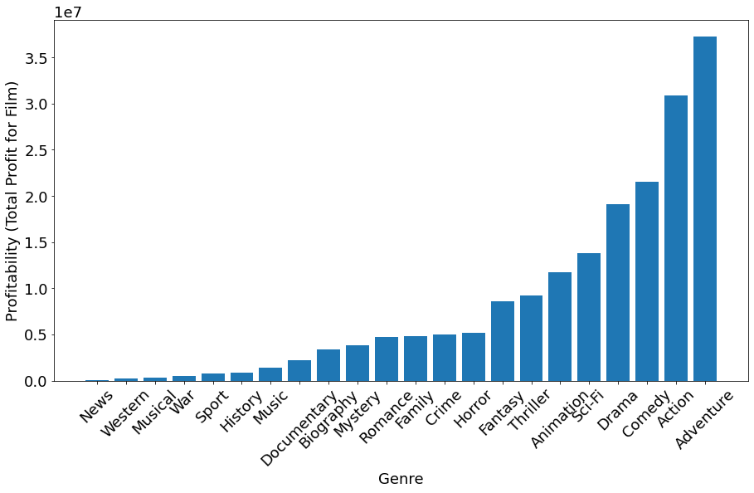
Average Profitability by Genre
Adventure
Action
Comedy
Drama
Sci-Fi
Animation
Data Sources:
IMDB
The-Numbers.com

Slide 6
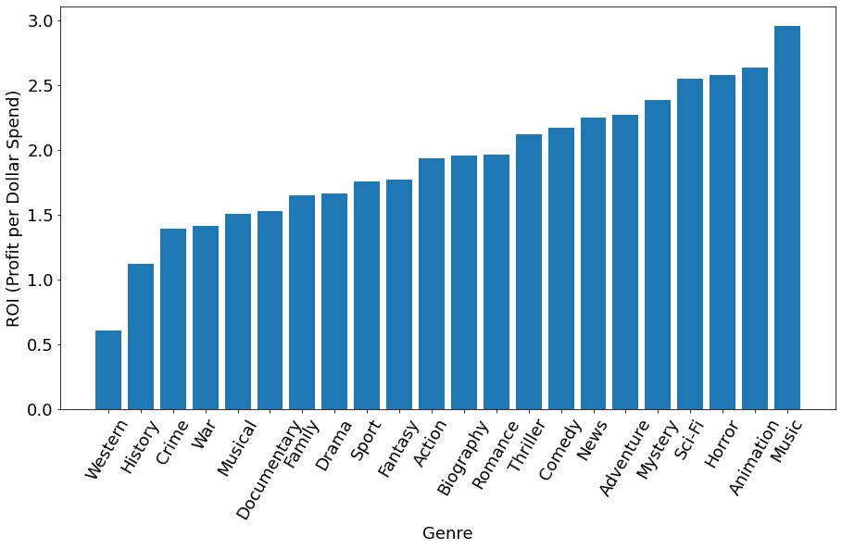
Average ROI by Genre
Adventure
Action
Comedy
Drama
Sci-Fi
Animation
Horror
Data Sources:
IMDB
The-Numbers.com

Slide 7
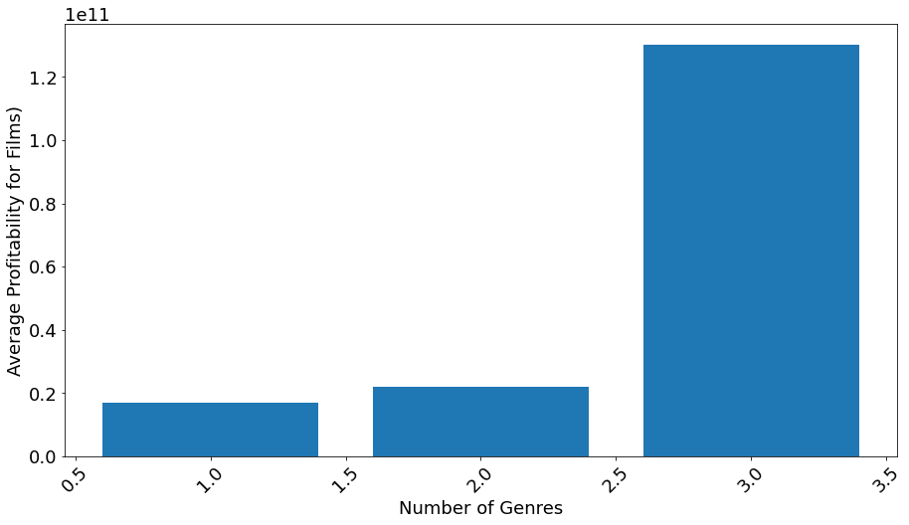
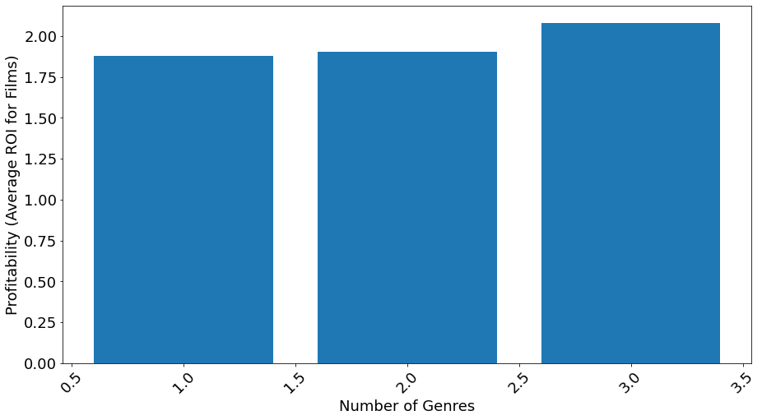
Returns by number of genres
Profitability by number of genres
ROI by number of genres

Slide 8
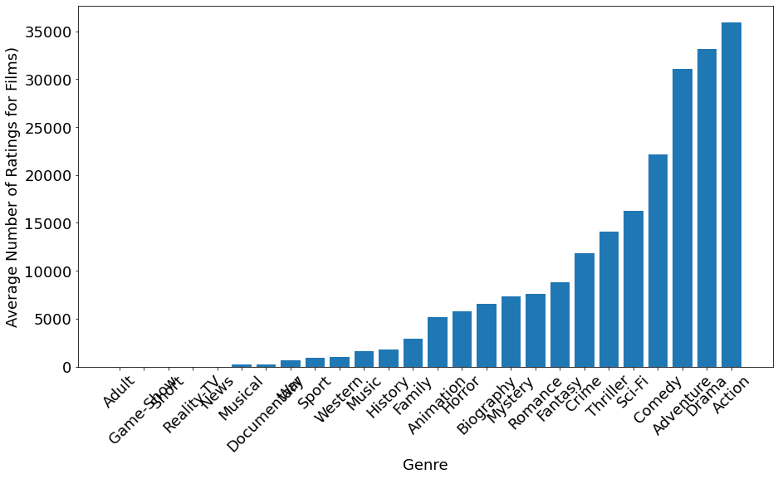
Average number of ratings by Genre
Adventure
Action
Comedy
Drama
Sci-Fi
Animation
Horror
Data Sources:
IMDB

Slide 9
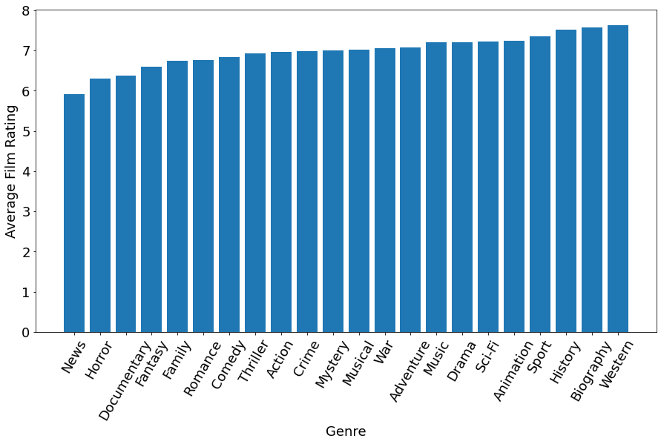
Average User Rating by Genre (IMDB)
Adventure
Sci-Fi
Animation
Action
Comedy
Drama
Biography
Data Sources:
IMDB

Slide 10
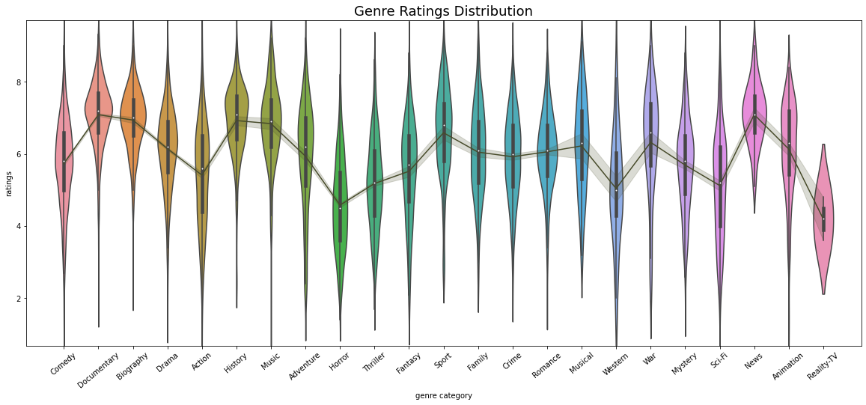
Distribution of ratings by genre

Slide 11
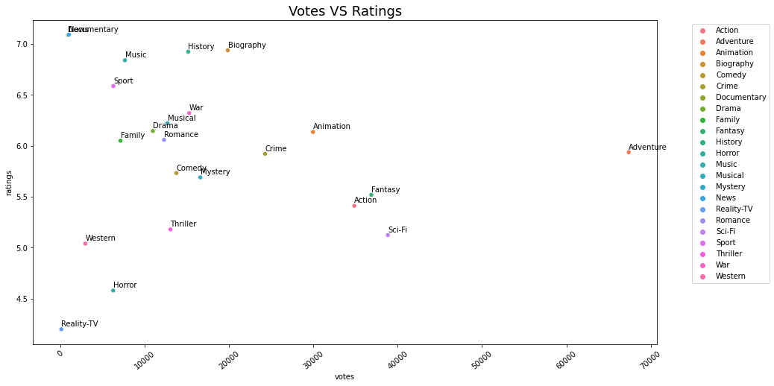
Correlation between ratings and votes

Slide 12
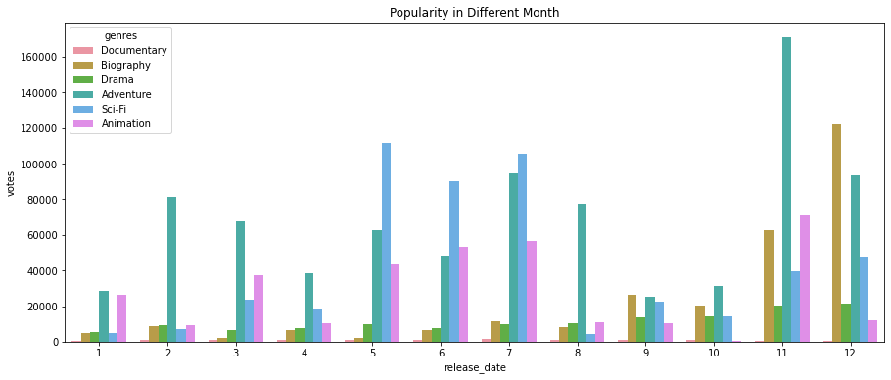
Viewer engagement of genres by month

Slide 13




Conclusion
Best Genres for profitability and engagement
Adventure
Sci-Fi
Animation
Action
Comedy
Drama
Biography
Release dates
Generally, release films during school breaks (Holidays and Early Summer)
Exception: late summer action/adventure films
Biography and Documentaries get late fall releases

Slide 14
THANK YOU
Mirjam Nilsson
mirjam@contoso.com
www.contoso.com

